Slide 1
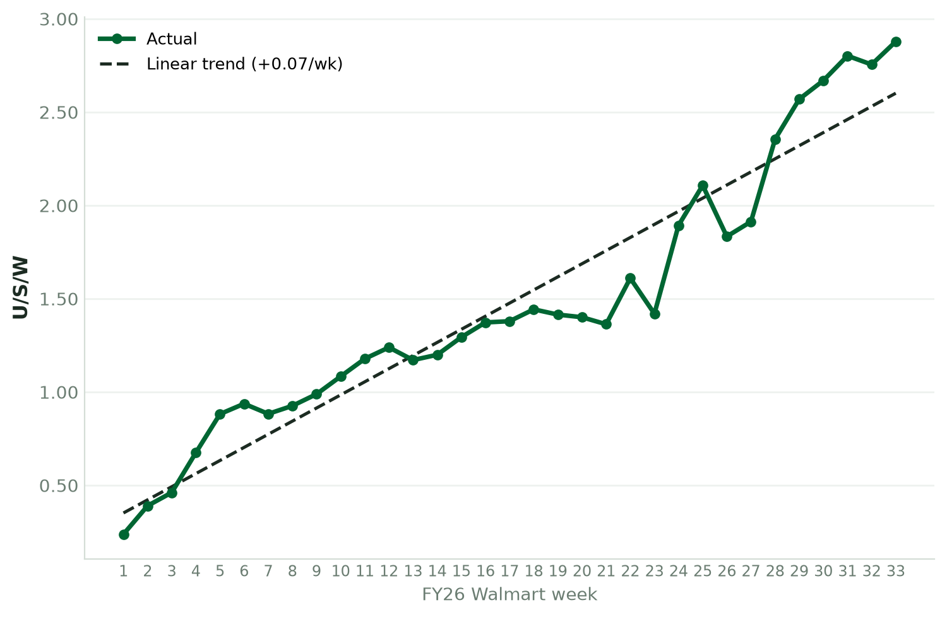

Significant Brick & Mortar Catalyst Growth
Fastest growing new brand at major retailer
(8 new brands/products launched same time as Catalyst)
2.9 Units per Store per week in first 8 months with ASP 52% higher than #1 selling cat litter SKU
Goal of 4 units/store/week
2.9
Units/Store/Week
in 8 months
Bringing in new consumers
29% All Time Repeat Purchase Rate Already
Estimated 40-50%+ repeat purchase rate for February-March cohort

